Slide 1
MY FIRST EXPERIENCE IN NAIROBI

Slide 2

I was very flabbergasted the first time I set my eyes in Nairobi.
I was astonished to see the tall buildings that made me wonder if it was truly Kenya.one of the buildings I saw was Times Tower.

Slide 3
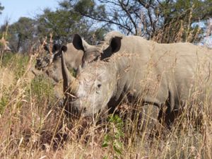
Due to the eagerness I had I started maneuvering the city. I was able to come a cross some of the wild animals that I never imagined if I will ever see them since I only heard my social studies teacher mentioning them. Example the rhino which is one of the big five animals in the world.

Slide 4
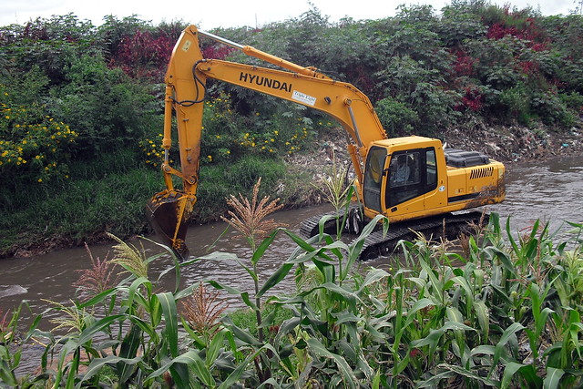
I was also able to see Nairobi river which supplies water to most residents and also used for irrigation.
The river is also used for recreation and I got a chance of riding a boat.

Slide 5
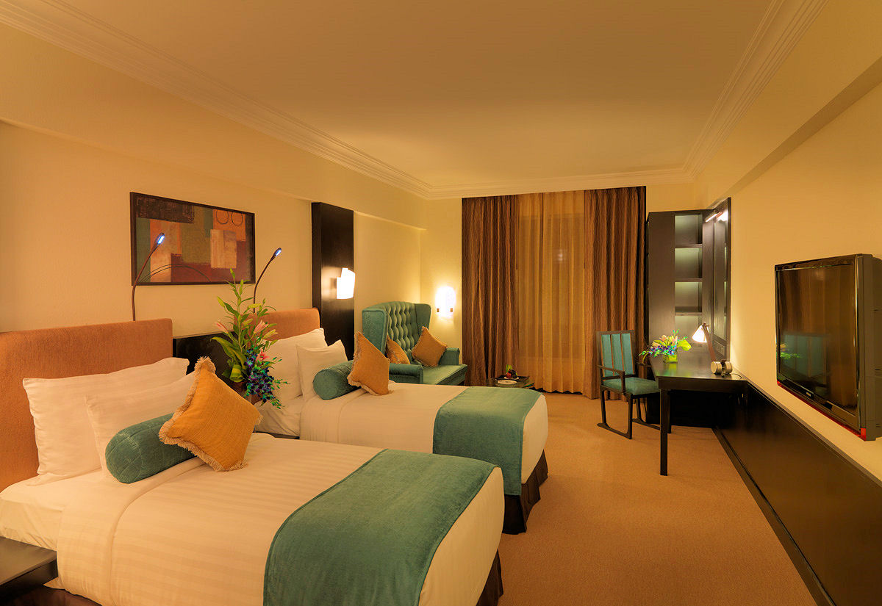
After along day of maneuvering I was hungry and I went to one of the luxurious hotels. The kind of food that met my eyes made them almost pop out of their sockets. A part from the foods the environment made me full though I was hungry.
I went to sleep and the rooms were attention
Catching.

Slide 6


THANK YOU ALL

